Slide 1
Neural Networks and Gradient Descent
Melissa Anthony and Micah Reid

Slide 2
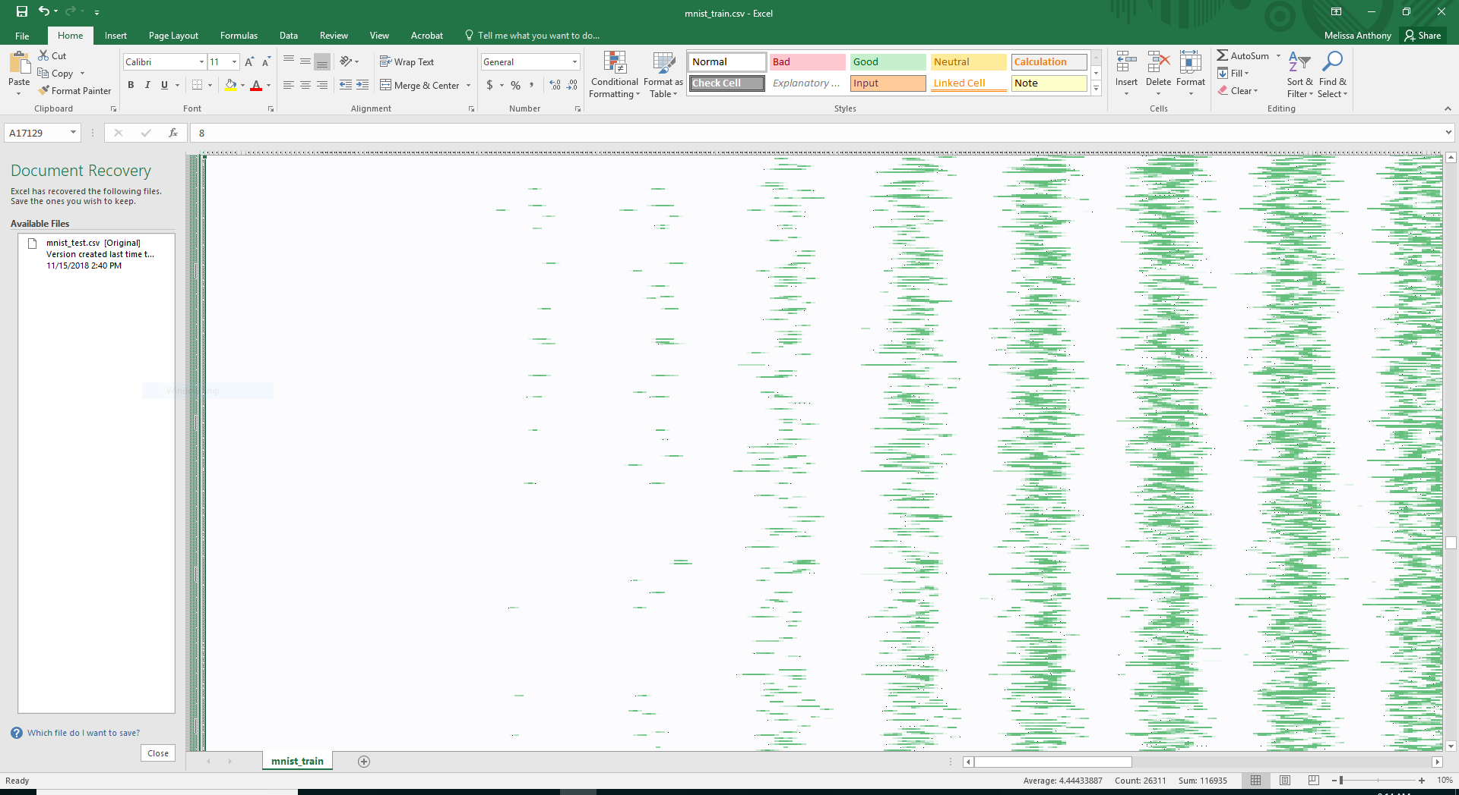

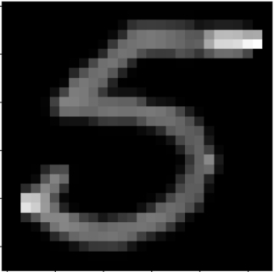
Notes:
Neural Networks are used for problems like pattern recognition. A classic problem for neural networks is recognizing handwritten numbers. Humans can tell that’s a 5 because our brains know what handwritten fives look like, but computers need neural networks based on the layers of neurons that human brains use for pattern recognition. To begin teaching the computer what a five, and a six, and all the other numbers look like, we first need a huge data set for training. It contains The pixels from the images of the handwritten numbers arranged in a list containing the brightness of the pixel. It’s mostly zeroes for empty space. On the spreadsheet on the left, you can see the number that was written, plus the beginning of the values representing the brightness of the pixels. On the spreadsheet on the right, you can see some of the vast amount of data we have, with the rows each being one handwritten letter and the columns being each pixel. You can see the darker cells that contain a larger number representing a pixel that isn’t blank.

Slide 3
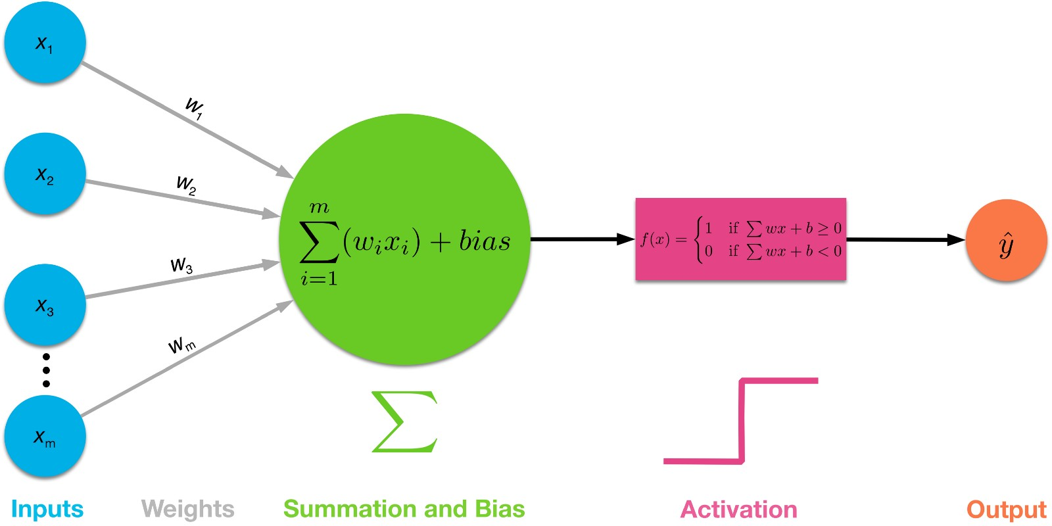
Notes:
Here we see several inputs to one node in a neural network. Each input is multiplied by the weight of the connection between the input and this node, and then the node sums all of those weights and adds it’s bias. Then, to determine the output of the node, it goes through an activation function. We used sigma, to give a probability, but this shows a binary activation function for a 1 or 0 output.

Slide 4
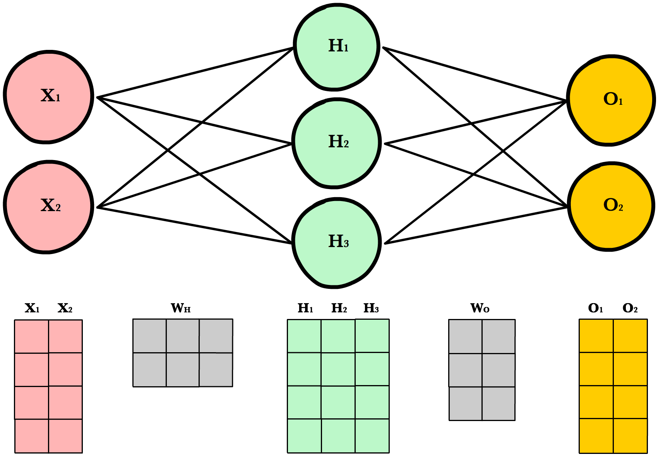
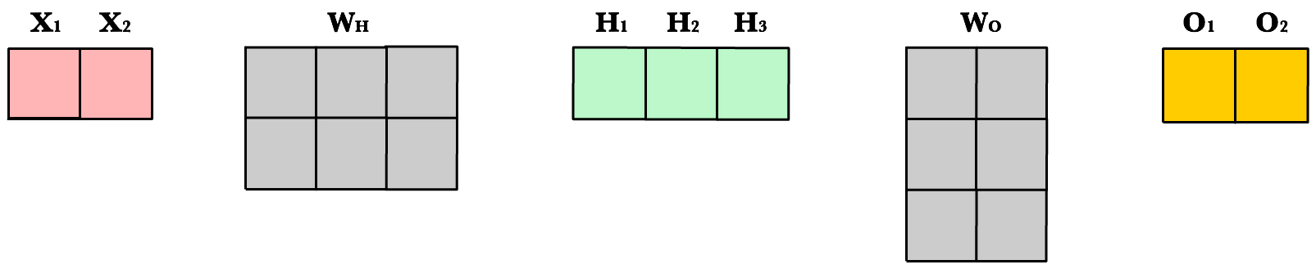
W₁₁
W₁₂
W₁₃
W₂₁
W₂₂
W₂₃
Notes:
We can work with large data sets using a dot product. When you input one data point, the input nodes are a 1 by 2 array, which gets multiplied by the 2 by 3 matrix that contains the weights to yield everything that gets passed into the hidden array.

Slide 5
.
.
Notes:
We can even train multiple inputs by changing the dimensions of our input matrix. We can add rows for each data we are using to input into our network, and the following dot products will adjust to output that same number of data points.

Slide 6
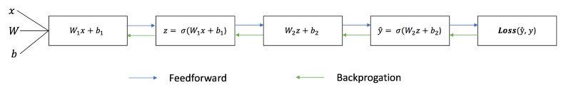
Notes:
We don’t just use a simple dot product though. At each step, we add a separate matrix called a bias, to adjust the activation. We call this sum z. We then put each z through the sigmoid function.

Slide 7
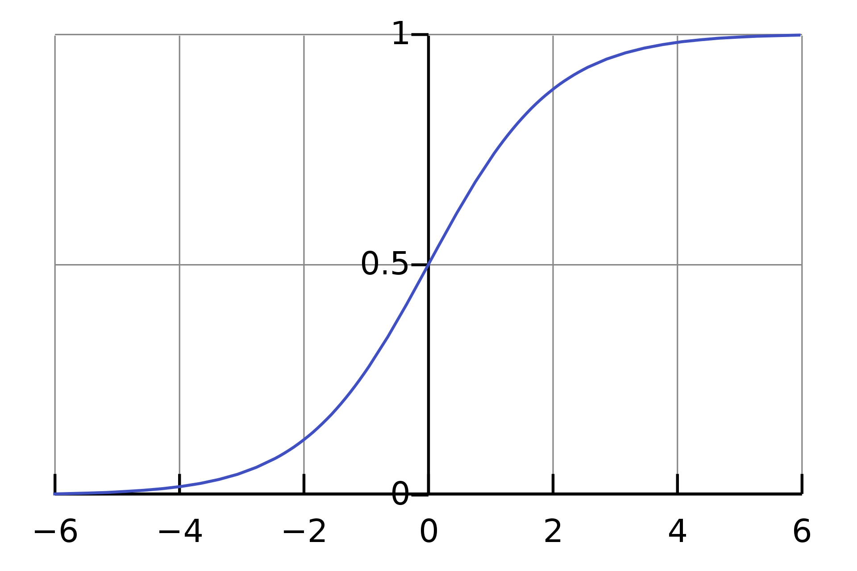
The Sigmoid Function
Notes:
We use the sigmoid function component wise on each entry of our matrices as our activation function. We use sigmoid because it is likely to give a value very close to one, or very close to zero, with most input numbers. In this way it works as an on/off switch, activating the relevant neurons or matrix entries.

Slide 8
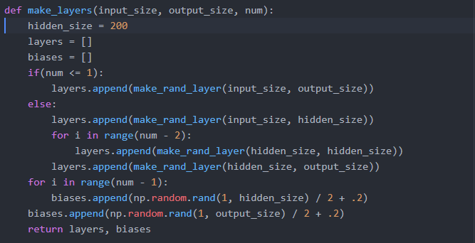
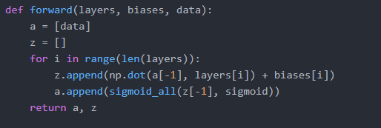

Notes:
Luckily, python makes this math super easy for us. We can easily create a list of weight layers and biases. See here that we make one weight layer and one bias matrix for each layer of our neural network, which can be altered through our num parameter. We then can pass these weights and biases through our forward propagation algorithm. However, if we stop at this step we have an untrained model, and its output is as good as guesswork. Here we can see this code being run to try to detect the number four. See that it thinks that there is only a 1% chance that this number is four, while it ranges between 12 and 99% certainty that it is other numbers

Slide 9
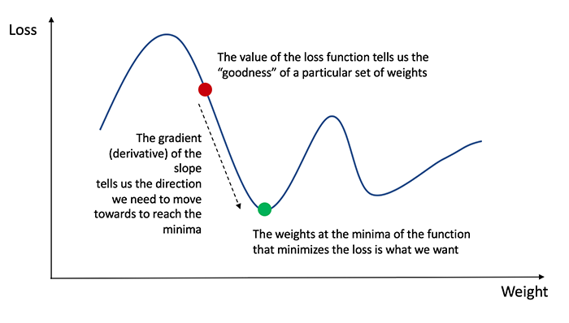
Backpropagation and Gradient Descent
Notes:
This is where backpropagation comes in! We talk about this in terms of cost, which is essentially a number that comes from the error or inaccuracy of our output If we can change the weights and biases incrementally to decrease the cost of our network, we can get much more accurate output. We do this through gradient descent, which is a partial derivative of each element in each weight and bias matrix. The partial derivative of each component in regards to cost gives us the slope, also known as the direction of steepest ascent. If we invert the sign of this partial derivative, we get the direction of steepest descent, also known as the change we want to make to get closer to our target of zero cost. When we have a slope of zero, the system assumes we have hit a minimum and we stop altering our weights and biases.

Slide 10

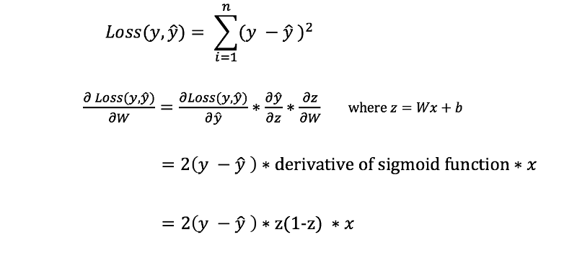
z1
z2
Notes:
We can do this using the chain rule. Finding the derivative of cost in regards to weights is hard, but we have equations for cost in terms of output, output in terms of z, and z in terms of weights, so we can multiply these partial derivatives together to get the one we want. We have demonstrated above the process for doing so for biases, with 2 times the difference in expected output and actual output being the cost derivative, the derivative of the sigmoid function of z being the output or activation derivative, and the previous input layer being the derivative of z. This is even simpler for the bias derivative, as we can just replace the derivative of z in terms of weights with the derivative of z in terms of biases, which is one.

Slide 11
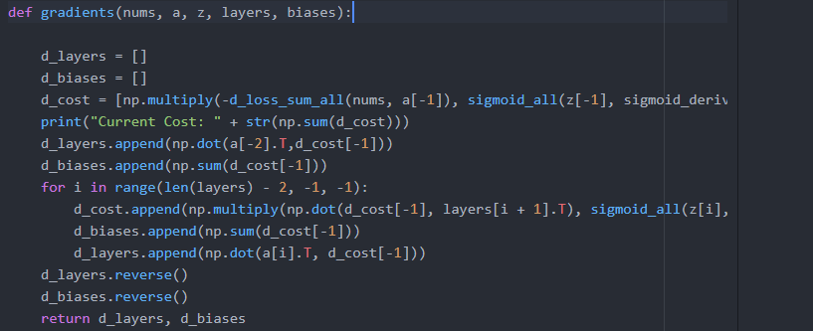
Results
Notes:
When we subtract our gradients from our code each time we forward propagate, our results become much more accurate. This example is after 50 training runs. See that it now detects a 77% chance of the number being four, with a maximum of a 12 percent chance that it is any other number! We can train with larger training sets and more runs, as well as change the number of layers and the batching for our runs to increase accuracy. At this point improvements are all up to computation time and choosing parameters that work best with your model. No matter what though, the underlying concepts of gradient descent will be driving this process.

Slide 12
Resources
Towardsdatascience.com article by James Loy:
https://towardsdatascience.com/how-to-build-your-own-neural-network-from-scratch-in-python-68998a08e4f6
FreeCodeCamp article by Daphne Cornelisse:
https://medium.freecodecamp.org/building-a-3-layer-neural-network-from-scratch-99239c4af5d3
Ava Lakmazaheri and Emily Lepert’s Linearity 2 Paper:
https://drive.google.com/file/d/1Z-xqGIVuRK9p1M4Qnov_orMx3R0ndbPq/view
3Blue1Brown Youtube Series on Neural Networks:
https://www.youtube.com/watch?v=aircAruvnKk
https://en.wikipedia.org/wiki/Sigmoid_function
https://ml-cheatsheet.readthedocs.io/en/latest/forwardpropagation.html

